Slide 1
Feral Friends
User Manual

Slide 2
Initial setup
To install this application please visit our github repository
https://github.com/hbrockster13/FeralFriends
Please follow all the directions to get the app started and your device set up
If you would like to use your own device and not an emulator please visit:
https://developer.android.com/training/basics/firstapp/running-app
Sign in to google in your settings under “Accounts” in order to have a smooth login experience

Slide 3
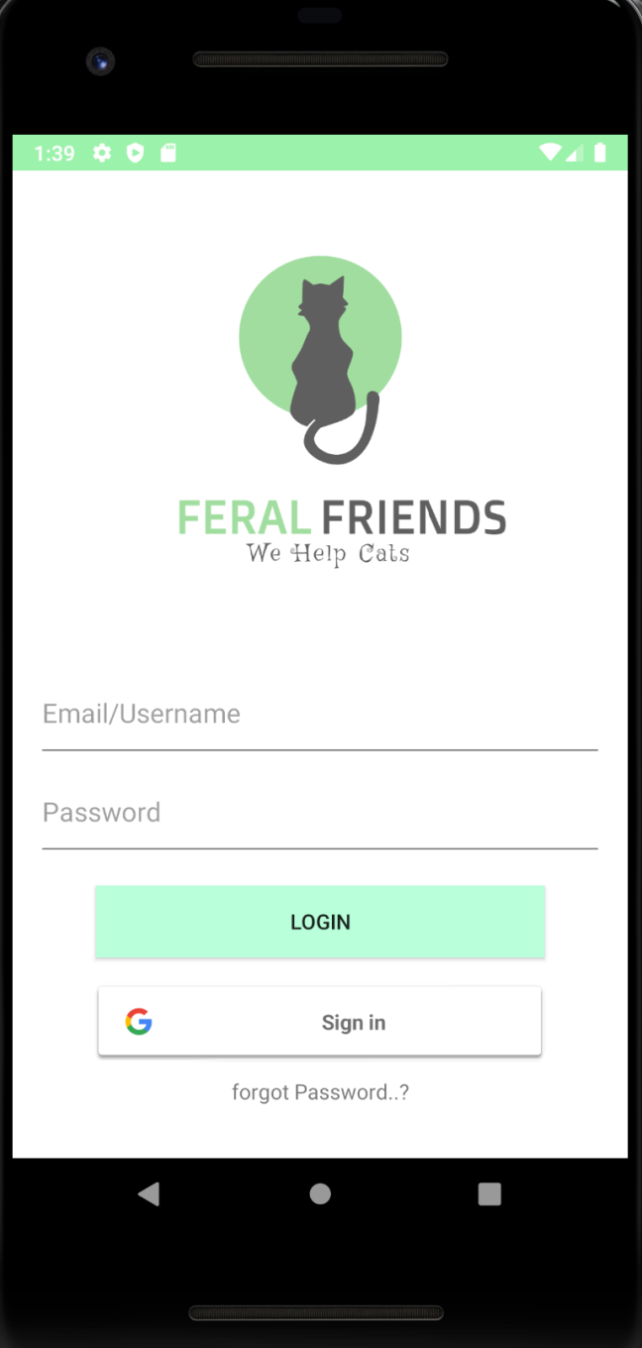
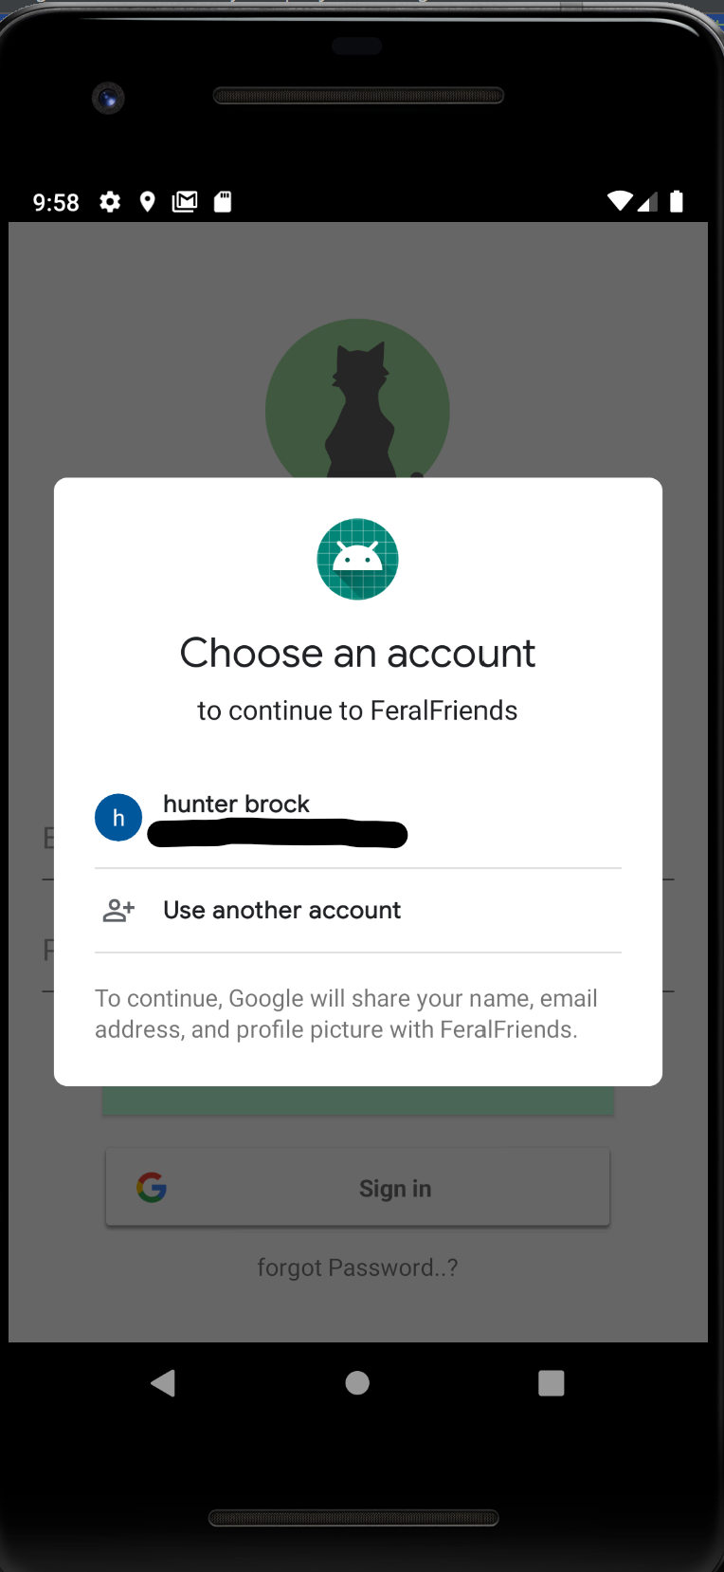
Logging in
Sign in with google account

Slide 4
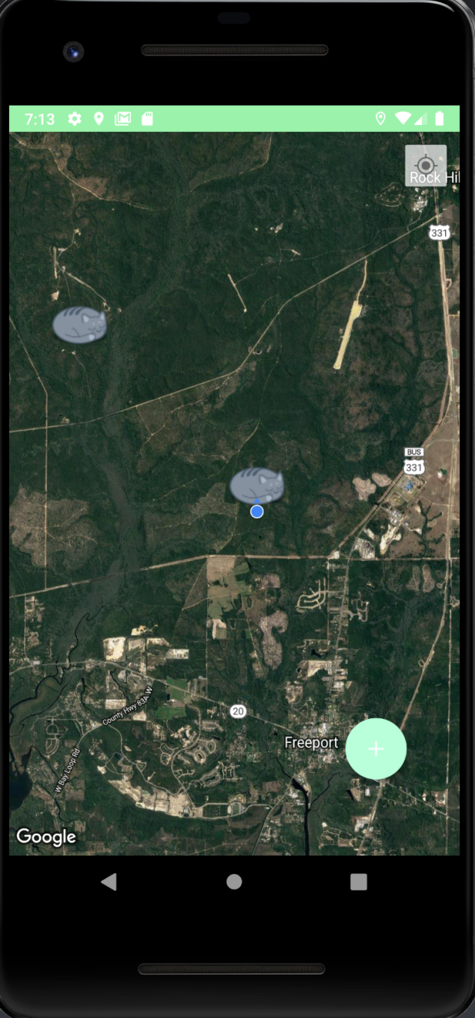
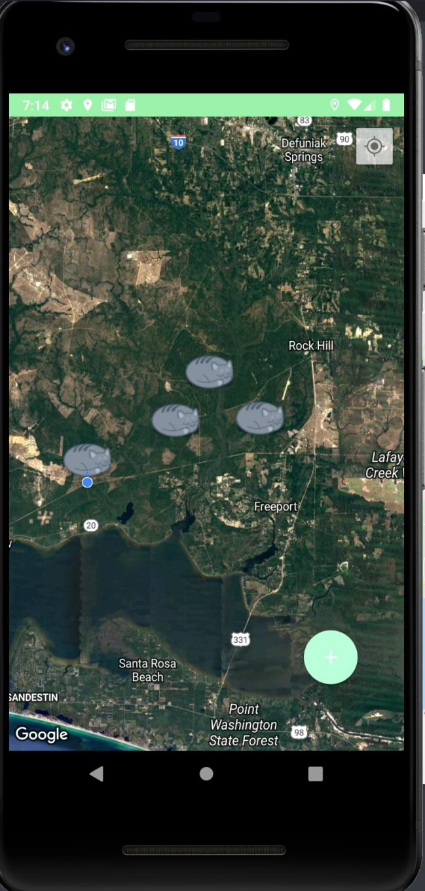

Navigating the Map
Use this button to center your location!
Use this map just like you would use Google Maps!

Slide 5
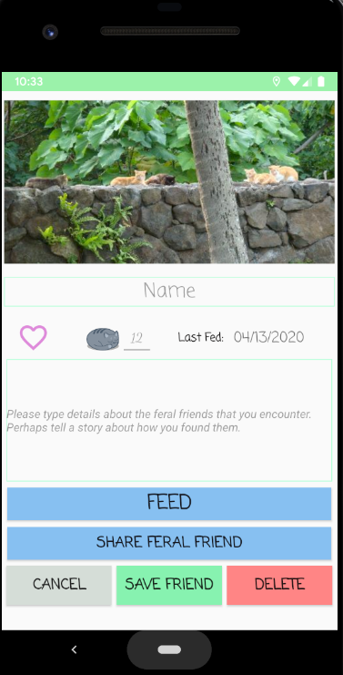
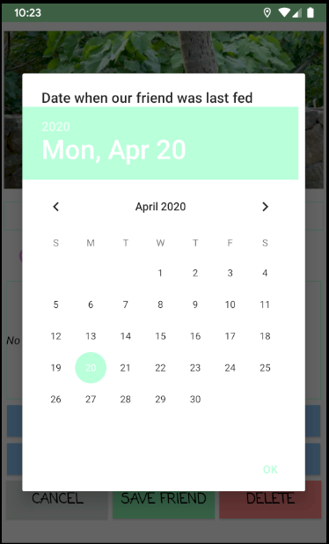
Adding a some feral friends!
Add a picture of feral friends
Don’t forget to name our feral friend colony!
TNR
Number of Friends
Press this button to add a colony at your current location!
Don’t forget to log feedings
Share freral friend with a human

Slide 6
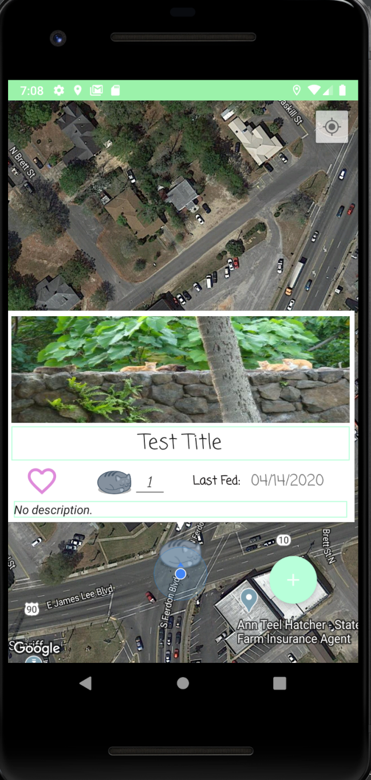
Peeking at local Feral Friends
BOOP
BOOP BOOP

Slide 7
Conclusion
If you have any questions please feel free to ask
Contact us:
Hunter Brock: hcb14@students.uwf.edu
Mark Bikakis: mjb91@students.uwf.edu
Tyler Woods: tmw42@students.uwf.edu

